Slide 1
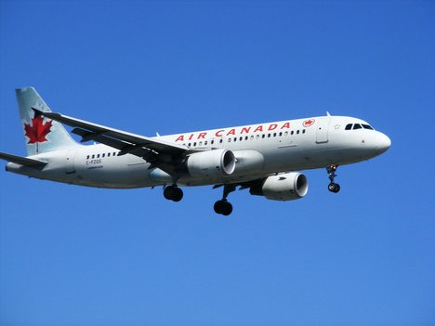
Who Cares About Dimensional Analysis?

Slide 2
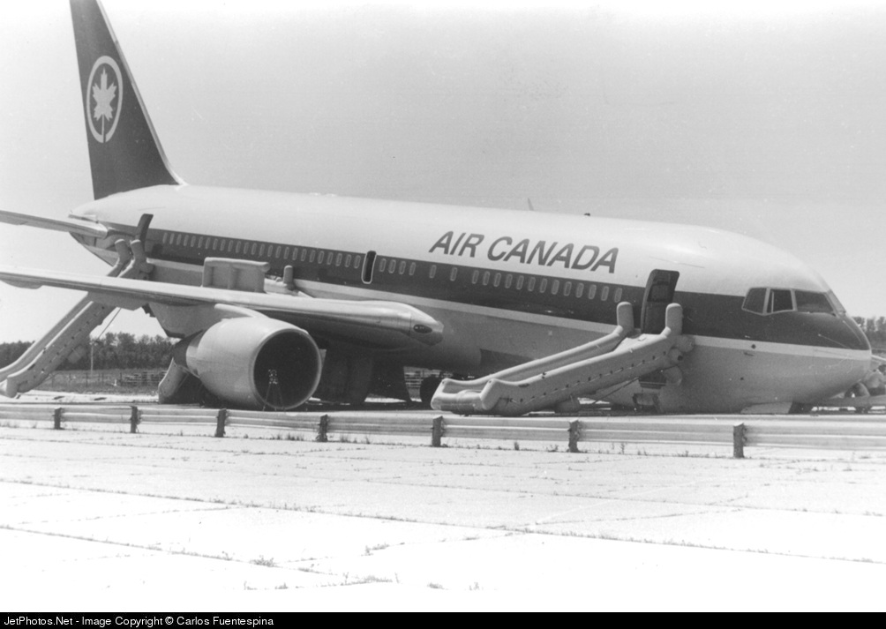
The Crew and passengers on Air Canada Flight 143 Do!

Slide 3
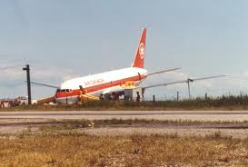
Watch what happened!
Youtube-(46 minutes in total-1st 20 minutes will give the idea) https://www.youtube.com/watch?v=8w5LqlTwbhs&feature=related

Slide 4
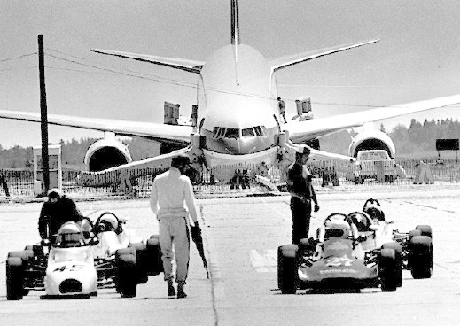
Dimensional Analysis means to:
“Examine the measurement of a physical object”
Analysis: Detailed examination of the elements or structure of something, typically as a basis for discussion or interpretation.
Dimension: The measurement of a length, width, or thickness.
Q. In this case, what was the physical object to be analyzed?
Fuel!

Slide 5
The Problem: The fuel measurement for Flight 143 should have been from a volume measurement of Liters to a mass measurement of Kilograms (kg). This would have been a metric conversion of volume to mass within the same system of measurement.
What happened? The fuel attendant converted volume of fuel in Liters to an English (Imperial) system of pounds.
Your Job: Determine how much fuel was actually put into the plane using Dimensional Analysis.

Slide 6
Dimensional Analysis Problem:
The Boeing 767 aircraft needed 22,300 kilograms (kg) of fuel but the plane left the airport with 22,300 pounds (lbs.) of fuel.
Use dimensional analysis to find the amount of fuel that was put into the jet from the fuel truck.
5 Steps to Solve:
#1) Determine your target! (What unit of measurement is asked in the problem?)
A. Kilograms (Go back a slide and look at the question again if you missed it!)
#2) Set up your “target” area in your equation like this:
___________kg = _______kg of jet fuel

Slide 7
Step #3: Determine the original physical “tangible” (touchable) object that needs to be converted. What is that in this problem?
A. The 22,300 pounds of fuel that was put into the airplane.
This is what your set up should look like so far.
22,300 lbs. of jet fuel ????? ___________kg = _______kg of jet fuel
(known/tangible) ???????????? (target!)
Notice the “gap” between the jet fuel “known” in pounds and the blank space by jet fuel in kilograms.
Q. What information do you think we’re missing? (Discuss this with a student near you-2 minutes!! ☺)

Slide 8
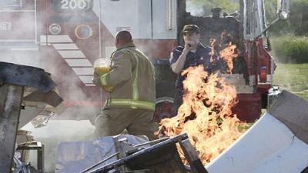
A. Conversion information!
Step #4) Obtain the “needed” conversion information and finish your set up!
Needed information = 2.2 pounds = 1 kilogram
22,300 lbs. of jet fuel ________1___kg = _______kg of jet fuel
2.2 lbs.
(known/tangible) conversion (target!)
Notice how the lbs cancel out and the kg do NOT! Keep what you want and cancel what you need to get rid of!
Step #5: Do the calculation! Multiply across the top and then divide by the number on the bottom. What answer do you get? How many kilograms of fuel was on the plane?

Slide 9
And the answer is?????
10,136.36 kg of jet fuel
Problem Solved: Pilots thought that they had 22,300 Kilograms of fuel NOT 22,300 pounds of fuel. So….. They had less than half of the fuel they needed to make it to their destination.
Q. How much more fuel did they need in kilograms?
A. 22,300 kilograms – 10,136 kilograms = 12, 164 kilograms

Slide 10
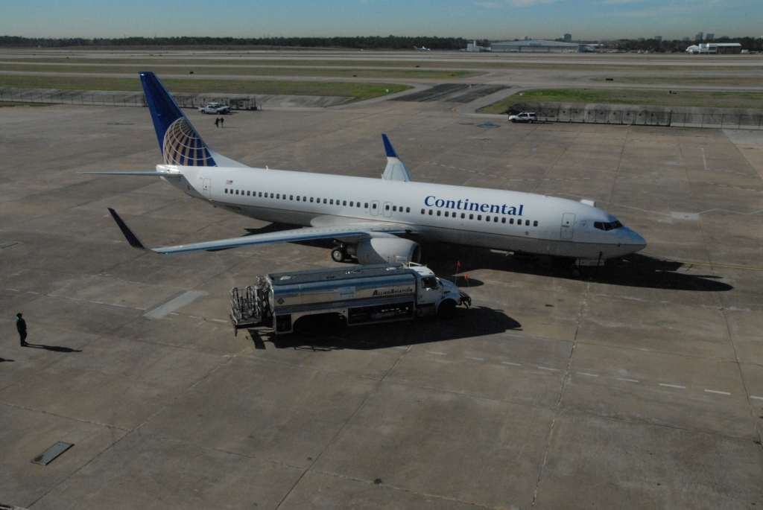
PRACTICE TIME!!!! TRY PROBLEMS ON YOUR OWN RIGHT NOW!!!
Do the following problem right now, at first on your own and then check your answer with a team partner.
Problem #1) A fuel attendant’s tanker truck measures fuel by volume. She knows that the jet needs 25,000 kg of fuel, a mass measurement. She needs to convert volume to the correct mass. There are 0.81 kg in every “1” liter of jet fuel. How many liters of fuel will she be pumping into the jet?
A. The fuel attendant needs = 30, 864.2 liters of fuel

Slide 11
Here’s the set up: (kg = abbreviation for kilogram)
25,000 kg of fuel x 1 liter = 30, 864.2 liters of fuel
0.81 kg
(known/tangible) conversion (target!)
Problem #2: What if the fuel attendant made the same mistake that the attendant did with Air Canada Flight 143? If she converted the 25,000 kg of fuel that her jet needed using a conversion for pounds instead of for kilograms then how many liters of fuel would she have put in the jet’s tanks? There are 1.78 lbs for every 1 liter of jet fuel.

Slide 12
25,000 kg of jet fuel x 1 liter = 14,045 liters of jet fuel
1.78 lbs.
Oops!!! Do you see the unit of measurement error here?
The units on the top MUST cancel out the units on the bottom!!
They cannot do this here because kg is on the top and lbs is on the bottom.
Q. How should this equation look in order to be correct? Write this out in your notes.
25,000 kg of jet fuel x 1 liter = 30, 864 liters of jet fuel
0.81 kg.

Slide 13
Contest time!
Team Competition for Homework Time in class!!!
The first table to have each student in their team have a practice problem correct (WITH WORK SHOWN) gets a stamp for that problem. Once you have stamps on all 5, you get the rest of the time in class to start your homework!
Do the practice problems and SHOW your work!!!
Check your answers with me as you bring your entire table team’s work with you!

Slide 14
Practice Problem #1 ☺
Four students want to take a road trip but they have limited funds. Genny’s car holds 4 people and gets 35 miles per gallon (mpg). They want to go to San Francisco for the day. The distance for them is 180 miles one way and fuel is $4.25/gallon. How much money would each student have to pitch in order for them to make it to San Francisco and back home again?
360 miles x 1 gallon x $4.25 = $43.71 round trip/4 students = $10.92
35 miles 1 gallon

Slide 15
Practice Problem #2 ☺
2) Mrs. Dibble was just beginning to teach her student’s about moles. She explained that a mole is a counting number, like a dozen, but much bigger! The mole is 6.02 x 10²³ particles. If a person masses out the correct molar mass in grams for a substance then she would have an entire mole of it. If the molar mass for H₂O is 18 g and Mrs. Dibble had 36 grams of H₂O then how many molecules did she have?
36 gram H₂O x 1 mole H₂O x 6.02 x 10²³ molecules = 1.204 x 10²² molecules
18 grams 1 mole

Slide 16
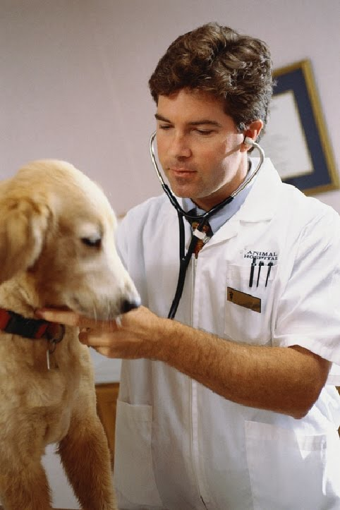
Practice Problem #3 ☺
3) Dr. LaHue had a canine patient that weighed 70 kg. The rather large dog needed some antibiotics and the dosage was 4 mg./kg. How many milligrams (mg) should Dr. LaHue give his patient?
70 kg. X 4 mg. = 280 mg antibiotics
1 kg

Slide 17
Practice Problem #4 ☺
4) Martha wanted to several boxes of shirts for the men in her family. The shirts were $29./box and there were 5 shirts per box. Each shirt sold separately for $6.25. How much would Martha pay for each shirt if she bought them by the box? Which is the better deal, to buy the shirts individually or to buy them by the box?
1 box x $29.00 = $5.80 (better deal to buy them by the box)
5 shirts 1 box
Helpful Hint: Notice that in this problem we keep both $ and “shirt” as units of measurement in the answer. Why? The question was, “How much would Martha pay for “each” shirt?” This means that this is cost “for every” or “for each” shirt. We must then keep shirt as a unit and not cancel it out!

Slide 18
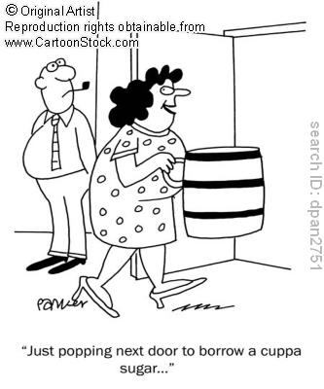
Practice Problem #5
Shaun wanted to borrow a cup of sugar from his neighbor. He was studying the chemical mole in class and knew that his neighbor was a chemistry professor so thought that he’d impress him by showing him how many moles of sugar he’d be borrowing. The molar mass for table sugar is 342 grams/mole. There are 200 g of sugar in a cup. How many mole’s of sugar would he get if he borrowed one cup? Would he get a full mole?
200 grams x 1 mole sugar = .58 moles/1 cup sugar
1 cup of sugar 342 grams

Slide 19
Wait!!
Wait!!
Q. Where did the 342 grams for sucrose come from? Do you remember how to find molar mass? Try this right now in your notes, using the Periodic Table of Elements.
The formula for table sugar or sucrose is C₁₂H₂₂O₁₁. Find the atomic mass (weight) for each element in the molecule and then multiply the mass times how many atoms there are of that element in the molecule.
C = 12 (at.mass) x 12 atoms = 144 g (reported in grams for molar mass)
H = 1 x 22 = 22 g
O = 16 x 11 = 176 g
Total Molar Mass = 342 g!!

Slide 20
Answers to Contest Questions
360 miles x 1 gallon x $4.25 = $43.71 round trip/4 students = $10.92
35 miles 1 gallon
2) 36 gram H₂O x 1 mole H₂O x 6.02 x 10²³ molecules = 1.204 x 10²⁴ molecules
18 grams 1 mole
3) 70 kg. X 4 mg. = 280 mg antibiotics
1 kg
4) 1 box x $29. = $5.80 /shirt (better deal to buy them by the box)
5 shirts 1 box
5) 200 grams x 1 mole sugar = .58 moles/1 cup
1 cup of sugar 342 grams

Slide 21
☺ HOMEWORK ☺
Using the Internet as your resource, find at least 2 catastrophe’s that have occurred because of an error in Dimensional Analysis.
Show your resources.
Write a clear, brief summary explaining and/or describing the catastrophe and in what way that dimensional analysis was involved in the error.
Be prepared to share your homework in class on ___________.

Slide 22
For the Teacher:
Websites that have listed catastrophes that involved dimensional analysis errors.
http://zone.ni.com/devzone/cda/pub/p/id/1353
http://www.mentalfloss.com/blogs/archives/68051

